Slide 1

ICTICT426 - Identify and evaluate emerging technologies and practices
Presentation

Slide 2

Chapter 1: Identify emerging technologies and practices in IT
Access sources of information on emerging technologies and practices in the IT industry
Identify and document emerging technologies and practices relevant to organisational context

Slide 3
Difference sources of information to identify emerging technologies
Information on few emerging technologies in IT industry
Few Trending Emerging technologies

Slide 4
Few Trending Emerging technologies
Internet of things (IOT)
Artificial intelligence (AI)
Augmented reality/ virtual reality(VR)
3D printing
Blockchain

Slide 5

Internet of things (IOT)
The network of physical devices, vehicles, home appliances and other items embedded with electronics, software, sensors, actuators, and connectivity which enables these objects to connect and exchange data."

Slide 6
Pros and Cons
Pros:
Cost savings
Information
Communication
Automation and Control
Cons:
Over Dependency on Technology
Losing Security on Privacy
Lesser Employment Prospects
Complexity

Slide 7
Pros of Internet-of-Things:
1. Cost Savings
It makes the electronic appliances communicate with each other in an effective manner thereby conserving and saving cost and energy
Hence: It’s helpful to people in their daily routines.
By allowing the data to be shared and communicated between electronic devices and then translating it into our required way, IoT is making our systems efficient

Slide 8
Pros of Internet-of-Things:
2. Information
It is true that with more information, you can make better decisions.
Whether it is general decisions as needing to know what to buy at a grocery store or if your company has enough supplies and widgets, knowledge is a great power and more knowledge is always good.

Slide 9
Pros of Internet-of-Things:
3. Communication
IoT encourages Machine-to-Machine (M2M) communication (communication between devices).
Owing to this, the physical devices are capable to stay connected; hence, total transparency is available with greater quality and lesser inefficiencies.

Slide 10
Pros of Internet-of-Things:
4. Automation and Control
Owing to physical objects getting controlled and connected digitally with wireless infrastructure, there is a big amount of automation and control in the workings.
All the machines are capable to communicate with each other without human intervention which leads to prompt output.

Slide 11
Cons of the Internet of Things:
1. Over Dependency on Technology
At present, it is observed that the younger generation is a technology freak and they depend upon technology and its devices for every little thing.
With the help of IoT, this dependency will become even more in daily routines.
No application is free from fault and there are some hitches in each technical application.
Totally relying on IoT devices may create trouble in case of non-working or crash of an IoT infrastructure.

Slide 12
Cons of the Internet of Things:
2. Losing Security on Privacy
As there is the involvement of different technologies and devices, there is monitoring by more than one companies, which directly questions the security and privacy issues.
Data retrieval and storage also becomes a major concern for the companies because all of them are involved at the same time.
In case of keeping only one company, it may lead to the question of domination.

Slide 13
Cons of the Internet of Things:
3. Lesser Employment Prospects
With IoT, daily activities getting automated and naturally there will be fewer requirements of human resources and less educated staff, which may create employment issue in the society.

Slide 14
Cons of the Internet of Things:
4. Complexity
With all complex systems, there is the possibility of failure.
Failures could be a skyrocket in case of the Internet of Things.

Slide 15
Activity - IOT
Break into groups, and select one of the following IOT devices
Smart watch
Smart TV
Medical sensors
Smart security system (camera with Internet connectivity)
Smart pet feeder
As a group, find out information about your device
Discuss with the class the device, 2 pros and 2 cons
10 minutes research, 15 minutes discussion

Slide 16
Artificial Intelligence
Artificial Intelligence (AI) is a science and a set of computational technologies that are inspired by—but typically operate quite differently from—the ways people use their nervous systems and bodies to sense, learn, reason, and act.

Slide 17
Pros and Cons
Pros:
Improve Efficiency
Eradicate human error
Smart Technology
Cons:
Job losses
Robot Bosses
Man-made error

Slide 18
AI - Pros
Improve efficiency
The value of data is now as important to business as oil once was and there is a need to process this data quickly and accurately for real time results.
A good example of this type of AI is being used by DeepMind to diagnose sight-threatening eye conditions as accurately as the world's best clinicians.
Working with London-based Moorfields Eye Hospital and UCL's Institute of Ophthalmology, the results of their research could pave the way for the rollout of AI systems in hospitals across the country.
The AI system reduces the time doctors spend studying thousands of eye scans and can diagnose patients within seconds.

Slide 19
AI - Pros
Eradicate human error
From lapses in concentration to simple mistakes, even the best of us are prone to errors.
But an artificially intelligent machine built to perform a specific task has no such idiosyncrasies.
Online grocer Ocado uses automated machines in its warehouse, controlling thousands of robots, communicating with them 10 times a second to coordinate the movement of hundreds of thousands of crates.

Slide 20
AI - Pros
Smart technology
Much like Ocado, AI will be used to power much of our automated services in the future.
From self-driving cars, that use AI to navigate roads and asses’ obstructions, to smart cities that are predicted to greatly improve our environments.
An AI machine's ability to process large data sets quickly and accurately will be vital for many smart technologies and environment to operate.
An example of this is already in operation on many top range smartphones, where AI operates in the background constantly optimising its device.

Slide 21
AI - Cons
With great power, comes great responsibility

Slide 22
AI - Cons
Job losses
This is arguably the number one downside to AI consistently highlighted as a doom and gloom scenario were workers are laid off, unable to outperform machines.
Reports on this are conflicting. A recent study from PricewaterhouseCoopers (PwC) argued that AI will create just as many jobs as it culls. However, the report detailed that the new technologies will have an uneven effect on industries.
Where sectors like healthcare and education were predicted to benefit, laborious positions such as manufacturing and transportation operators were estimated to see the largest decreases in jobs. Former chess world champion Garry Kasparov has said these jobs losses were necessary to progress, arguing that it is outweighed by the societal good that AI can achieve.

Slide 23
AI - Cons
Robot bosses
If you have an issue with your current human boss, be thankful that he isn't a cold, emotionless machine because AI is already being used to monitor work productivity.
In what seems like the scary nightmares of a dystopian future, IBM's Watson has been using AI and Watson Analytics to decide if employees are worthy of a pay rise, a bonus or a promotion by looking at the experience and past projects of employees to judge the qualities and skills that individuals might have to serve the company in the future.

Slide 24
AI - Cons
Man-made error
Although AI can virtually remove human error from processes, it can still exist in the code, along with bias and prejudice. Being largely algorithm based, the technology can be coded to have a negative impact on certain demographics and discriminate against people.
Worryingly, if security is not 100%, hackers can take advantage of AI's thirst for knowledge. For example, Microsoft's ill-fated chatbot, Tay Tweets, had to be taken down after only 16 hours after it started to tweet racist and inflammatory content -- ideas it repeated from other Twitter users.

Slide 25
Activity - AI
Select one of the following AI systems
Watson (especially the “customer service” aspects)
Tay Tweets (how did it learn, what went wrong?)
Cambridge Analytica (where did they get the data, what went wrong?)
Siri and Alexa (pros and cons)
Netflix (how does it use AI?)
As a group, find out information about your AI
Discuss with the class the AI, pros and cons
10 minutes research, 15 minutes discussion

Slide 26
Augmented Reality & Virtual Reality
Augmented reality (AR) and virtual reality (VR) are becoming mainstream and have become a worthwhile topic in many industries. VR and AR development can be applied towards gaming, entertainment, marketing, education, fashion, art, and so much more. These are exciting new technologies that are being improved every day.

Slide 27
Difference between AR and VR
The terms "virtual reality" and "augmented reality" get thrown around a lot these days, thanks to the resurgence of VR headsets heralded by the Oculus Rift and the use of AR apps and games Go. They sound similar, and as the technologies develop, they bleed over into each other a bit. They're two very different concepts, though, with characteristics that readily distinguish them from one another.

Slide 28
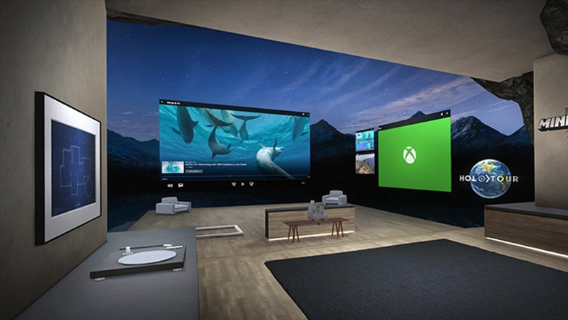
Virtual Reality (VR)
VR headsets completely take over your vision to give you the impression that you're somewhere else. The HTC Vive, the Oculus Rift, and other headsets are completely opaque, blocking out your surroundings when you wear them. If you put them on when they're turned off, you might think you're blindfolded.

Slide 29
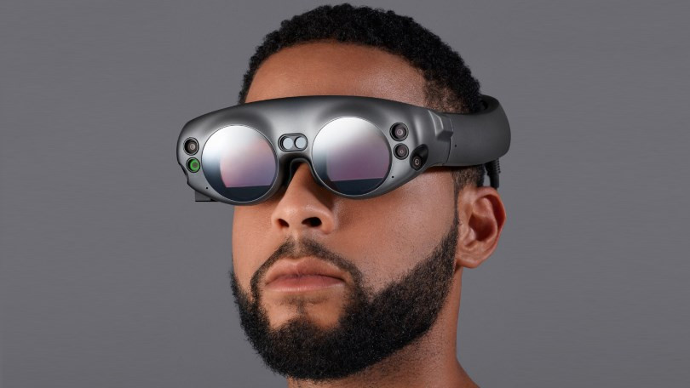
Augmented Reality(AR)
Whereas virtual reality replaces your vision augmented reality adds to it. AR devices like the Microsoft HoloLens and various enterprise-level "smart glasses" are transparent, letting you see everything in front of you as if you are wearing a weak pair of sunglasses. The technology is designed for completely free movement while projecting images over whatever you look at. The concept extends to smartphones with AR apps and games like Pokémon Go, which use your phone's camera to track your surroundings and overlay additional information on top of it, on the screen.

Slide 30
AR – Quick research
Quickly research “Google Glass” or just “Glass”
What is it used for?
How does it work?
What were the criticisms?
5 minutes research
5 minutes discussion

Slide 31


3D Printing Technology
3D printing is a fast-growing additive manufacturing technology, which uses powder materials such as metal or plastic to construct object based on the digital model file. 3D printing is an emerging high-end manufacturing technology, which is widely used in manufacturing and other fields. In the past years, this technology has changed the pattern of the manufacturing sector quietly.

Slide 32
3D printing - controversies
Google the term “3D printing liberator”
What was the liberator?
What are the issues?
As a society, how do we face them?
5 minutes research
5 minutes discussion

Slide 33

Blockchain
A blockchain is a write-only database dispersed over a network of interconnected computers that uses cryptography (the computerized encoding and decoding of information) to create a tamperproof public record of transactions. Blockchain technology is transparent, secure and decentralised, meaning no central actor can alter the public record. In addition, financial transactions carried out on blockchains are cheaper and faster than those performed by traditional financial institutions. These properties are at the heart of this technology’s rapid expansion.

Slide 34
Pros & cons of Blockchain
Pros:
Transparency
Accounting
Supply Chain Management
Peer to peer global transactions
Process integrity
Lower Transaction Costs
Cons:
Blockchain is Everlasting
Miners Provide Network Security
Indestructible
Performance
Signature Verification
Consensus mechanisms
Redundancy

Slide 35
Blockchain
Research each of the following, and describe how blockchain is used:
Cryptocurrencies
Financial services (e.g. banks)
Supply chain (monitoring goods transfers)
Food safety
Digital voting
10 minutes research
15 minutes discussion

Slide 36
Questions?
?

